Slide 1

COMPUTER GRAPHICS
Hochiminh city University of Technology
Faculty of Computer Science and Engineering
CHAPTER 3:

Slide 2
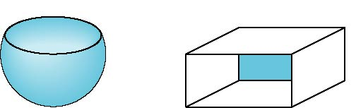

Front and Back Faces
The default is shade only front faces which works correctly for convex objects
If we set two sided lighting, OpenGL will shade both sides of a surface
Each side can have its own properties which are set by using GL_FRONT, GL_BACK, or GL_FRONT_AND_BACK
back faces not visible
back faces visible

Slide 3
Front and Back Faces
Specify Front Faces
  glFrontFace(GL_CCW), glFrontFace(GL_CW)
Cull Face
  glEnable(GL_CULL_FACE)
  glCullFace(GLenum mode);
    GL_FRONT,
    GL_BACK,
    GL_FRONT_AND_BACK

Slide 4
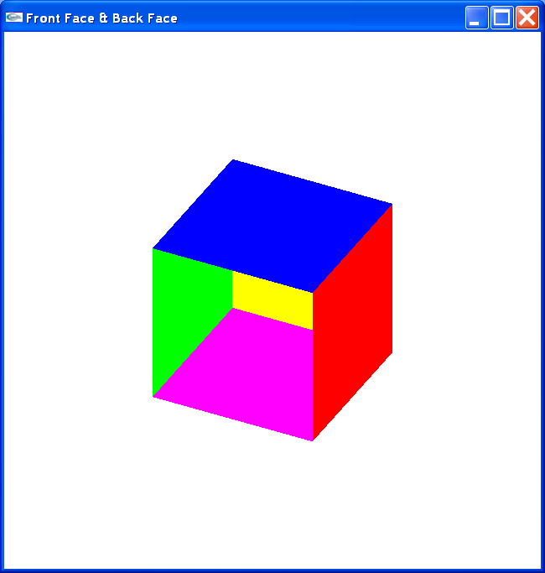
Front and Back Faces

Slide 5
Front and Back Faces
glBegin(GL_QUADS);
glColor3f(1, 0, 0); // x = 1
glVertex3f(1, 1, 1); glVertex3f(1, -1, 1);
glVertex3f(1, -1, -1); glVertex3f(1, 1, -1);
glColor3f(0, 1, 0); //x = -1
glVertex3f(-1, 1, 1); glVertex3f(-1, 1, -1);
glVertex3f(-1, -1, -1); glVertex3f(-1, -1, 1);
glColor3f(0, 0, 1); // y = 1
glVertex3f( 1, 1, 1); glVertex3f( 1, 1, -1);
glVertex3f(-1, 1, -1); glVertex3f(-1, 1, 1);
glColor3f(1, 0, 1); // y = -1
glVertex3f( 1, -1, 1); glVertex3f(-1, -1, 1);
glVertex3f(-1, -1, -1); glVertex3f( 1, -1, -1);
    ……………… // z = -1
glEnd();

Slide 6
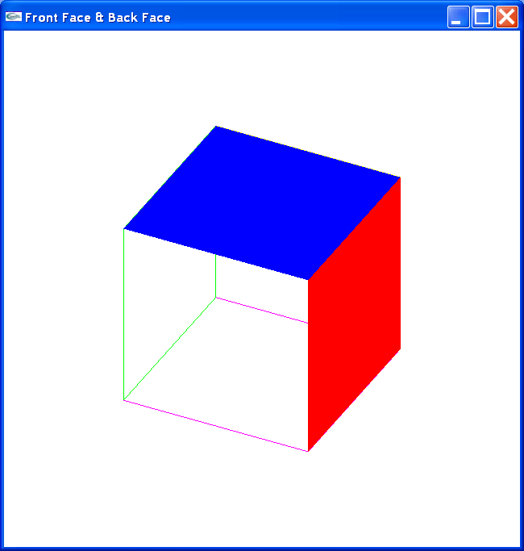
Front and Back Faces
glPolygonMode(GL_FRONT, GL_FILL);
glPolygonMode(GL_BACK, GL_LINE);

Slide 7
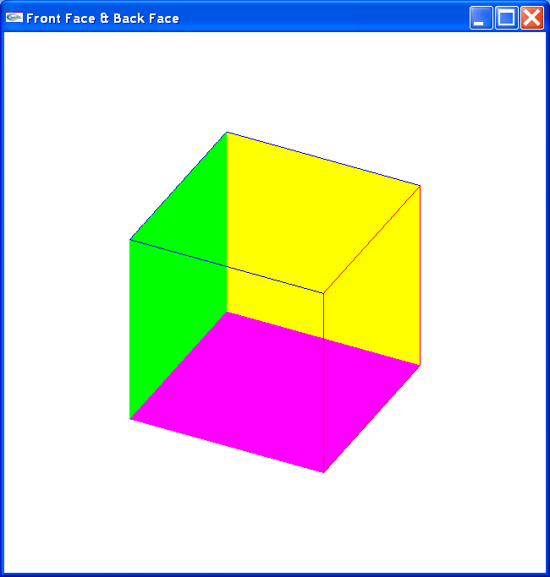
Front and Back Faces
glFrontFace(GL_CW);
glPolygonMode(GL_FRONT, GL_FILL);
glPolygonMode(GL_BACK, GL_LINE);

Slide 8
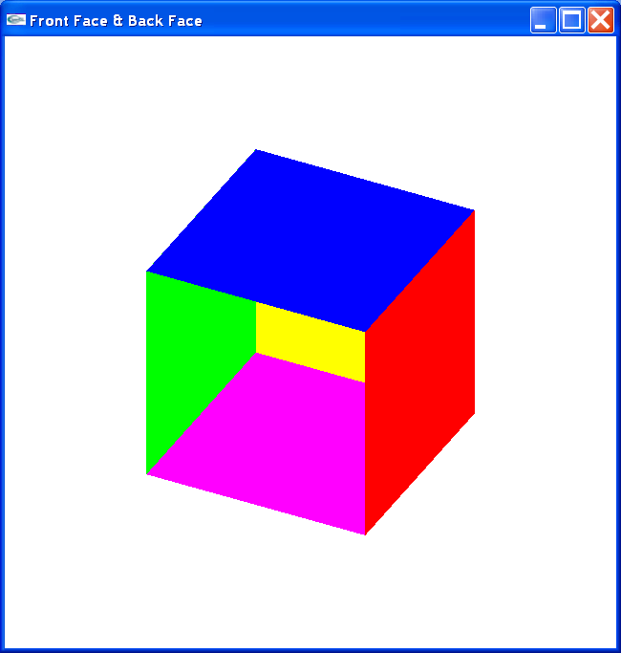
Front and Back Faces
glFrontFace(GL_CCW); //default
glPolygonMode(GL_FRONT, GL_FILL);
glPolygonMode(GL_BACK, GL_FILL);

Slide 9

Front and Back Faces
glFrontFace(GL_CCW);
glEnable(GL_CULL_FACE);
glCullFace(GL_BACK);

